Slide 1


Bitcoin Price Prediction using Tweets
Team 4
Han Chen
Daniel Fernandez
May 8, 2018

Slide 2
AGENDA
Motivation
Dataset & Data Preparation
Feature Selection
Models
Results
Conclusions
Future Work

Slide 3
“It [Bitcoin] can only go UP UP UP!"
Bruce Wagner - American novelist & actor
"If you look back in history in terms of financial bubbles, they always end. It's going to be a very rough ride for guys that invest in Bitcoin for speculative purposes."
Alistair Cotton - Senior analyst with Currencies Direct

Slide 4
Motivation
Many of the choices we make are influenced by others’ opinions. Recently social media has gained traction on this matter.
Bitcoin has been a hot topic recently, and its prices seem to be driven by speculative trends. Some of these speculative trends and Bitcoin enthusiasm/aversion is probably spread across social networks.
We aim to to use Machine Learning methods to predict the Bitcoin market movement based on Tweets. As we have the movement in price and the tweets, it is a classification problem.

Slide 5
II. Datasets (1 / 2)
We merged two Datasets to perform our analysis. One consisting on Bitcoin Prices and the other consisting on Tweets.
Bitcoin Data:
Got it from a Kaggle Dataset, obtained from Poloinex API.
Price information from 04/23/2017 to 04/05/2018 with 5 minute intervals.
The attributes are: Timestamp, Closing price, Opening Price, Volume, Average, Low and High.

Slide 6
II. Datasets (2 / 2)
Twitter Data
Used Tweepy API to scrape tweets related to Bitcoin.
Tweepy have a limit of scraping 7 days back on “topics”.
But allows to scrape on individuals (up to 3,000+ tweets per user). We looked for Bitcoin “influencers” on Twitter. (People who tweet constantly about Bitcoin and have more than 10k followers):
Bitcoin Analysts
Bitcoin Investors
Bitcoin News
Standard news (The Economist, Bloomberg, etc.)
We got a list of influencers consisting of 77 people, with a total of 68K tweets.
Features: timestamp, user, tweet content

Slide 7
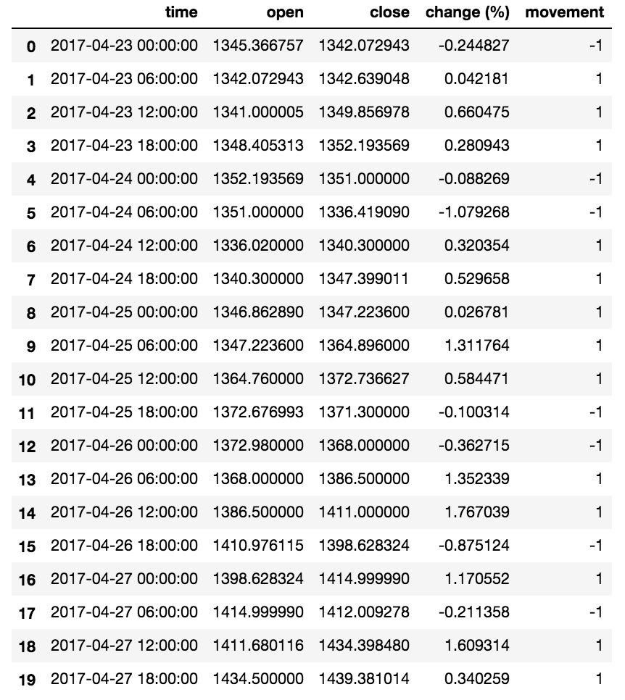
II. Data Preparation
Bitcoin Data
Group the data by 6-hour interval
Extract the opening and closing price of each interval
Compute price change in percentage
→ “change (%)”
Label “movement” as
1 if “change (%)” > 0
-1 if “change (%)” < 0

Slide 8
II. Data Preparation
Cleaning Tweets Dataset
We filtered tweets not containing Bitcoin related content (using regex patterns, we kept only tweets containing bitcoin, cryptocurrency, btc, etc)
Several tweets had noise on the text: links, special characters, symbols, etc. We cleaned the tweets from these special characters:

Slide 9
II. Data Preparation
Merging
Merge the Bitcoin data with preprocessed tweets data
Resulting data frame consists of features:
date & time, opening price, closing price, price change in percentage, market movement label, number of tweets posted, and text
in 6-hour interval

Slide 10
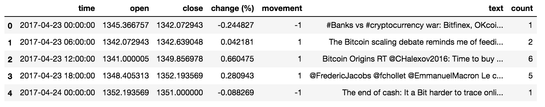
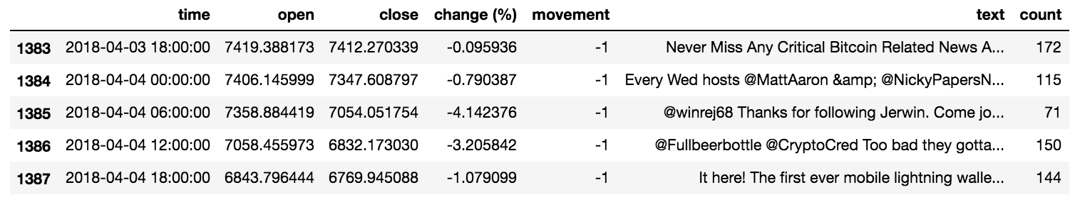
II. Data Preparation
04/23/2017 - 04/04/2018

Slide 11
III. Feature Selection
After removing stop words, we created the feature space from the tweets in 3 different ways:
Bag of Words:
Created a Matrix of tweets-words, which counts the occurrences of each word in the tweets of 6-hour interval. Hence, the columns are words and the values of the columns are occurrences.
2) Term Frequency times Inverse Document Frequency (TF-IDF):
Created a TF-IDF Matrix, which results from dividing the number of occurrences of each word in a tweet by the total number of words in the tweet. And additionally, downscaling weights for words that occur in many tweets.

Slide 12
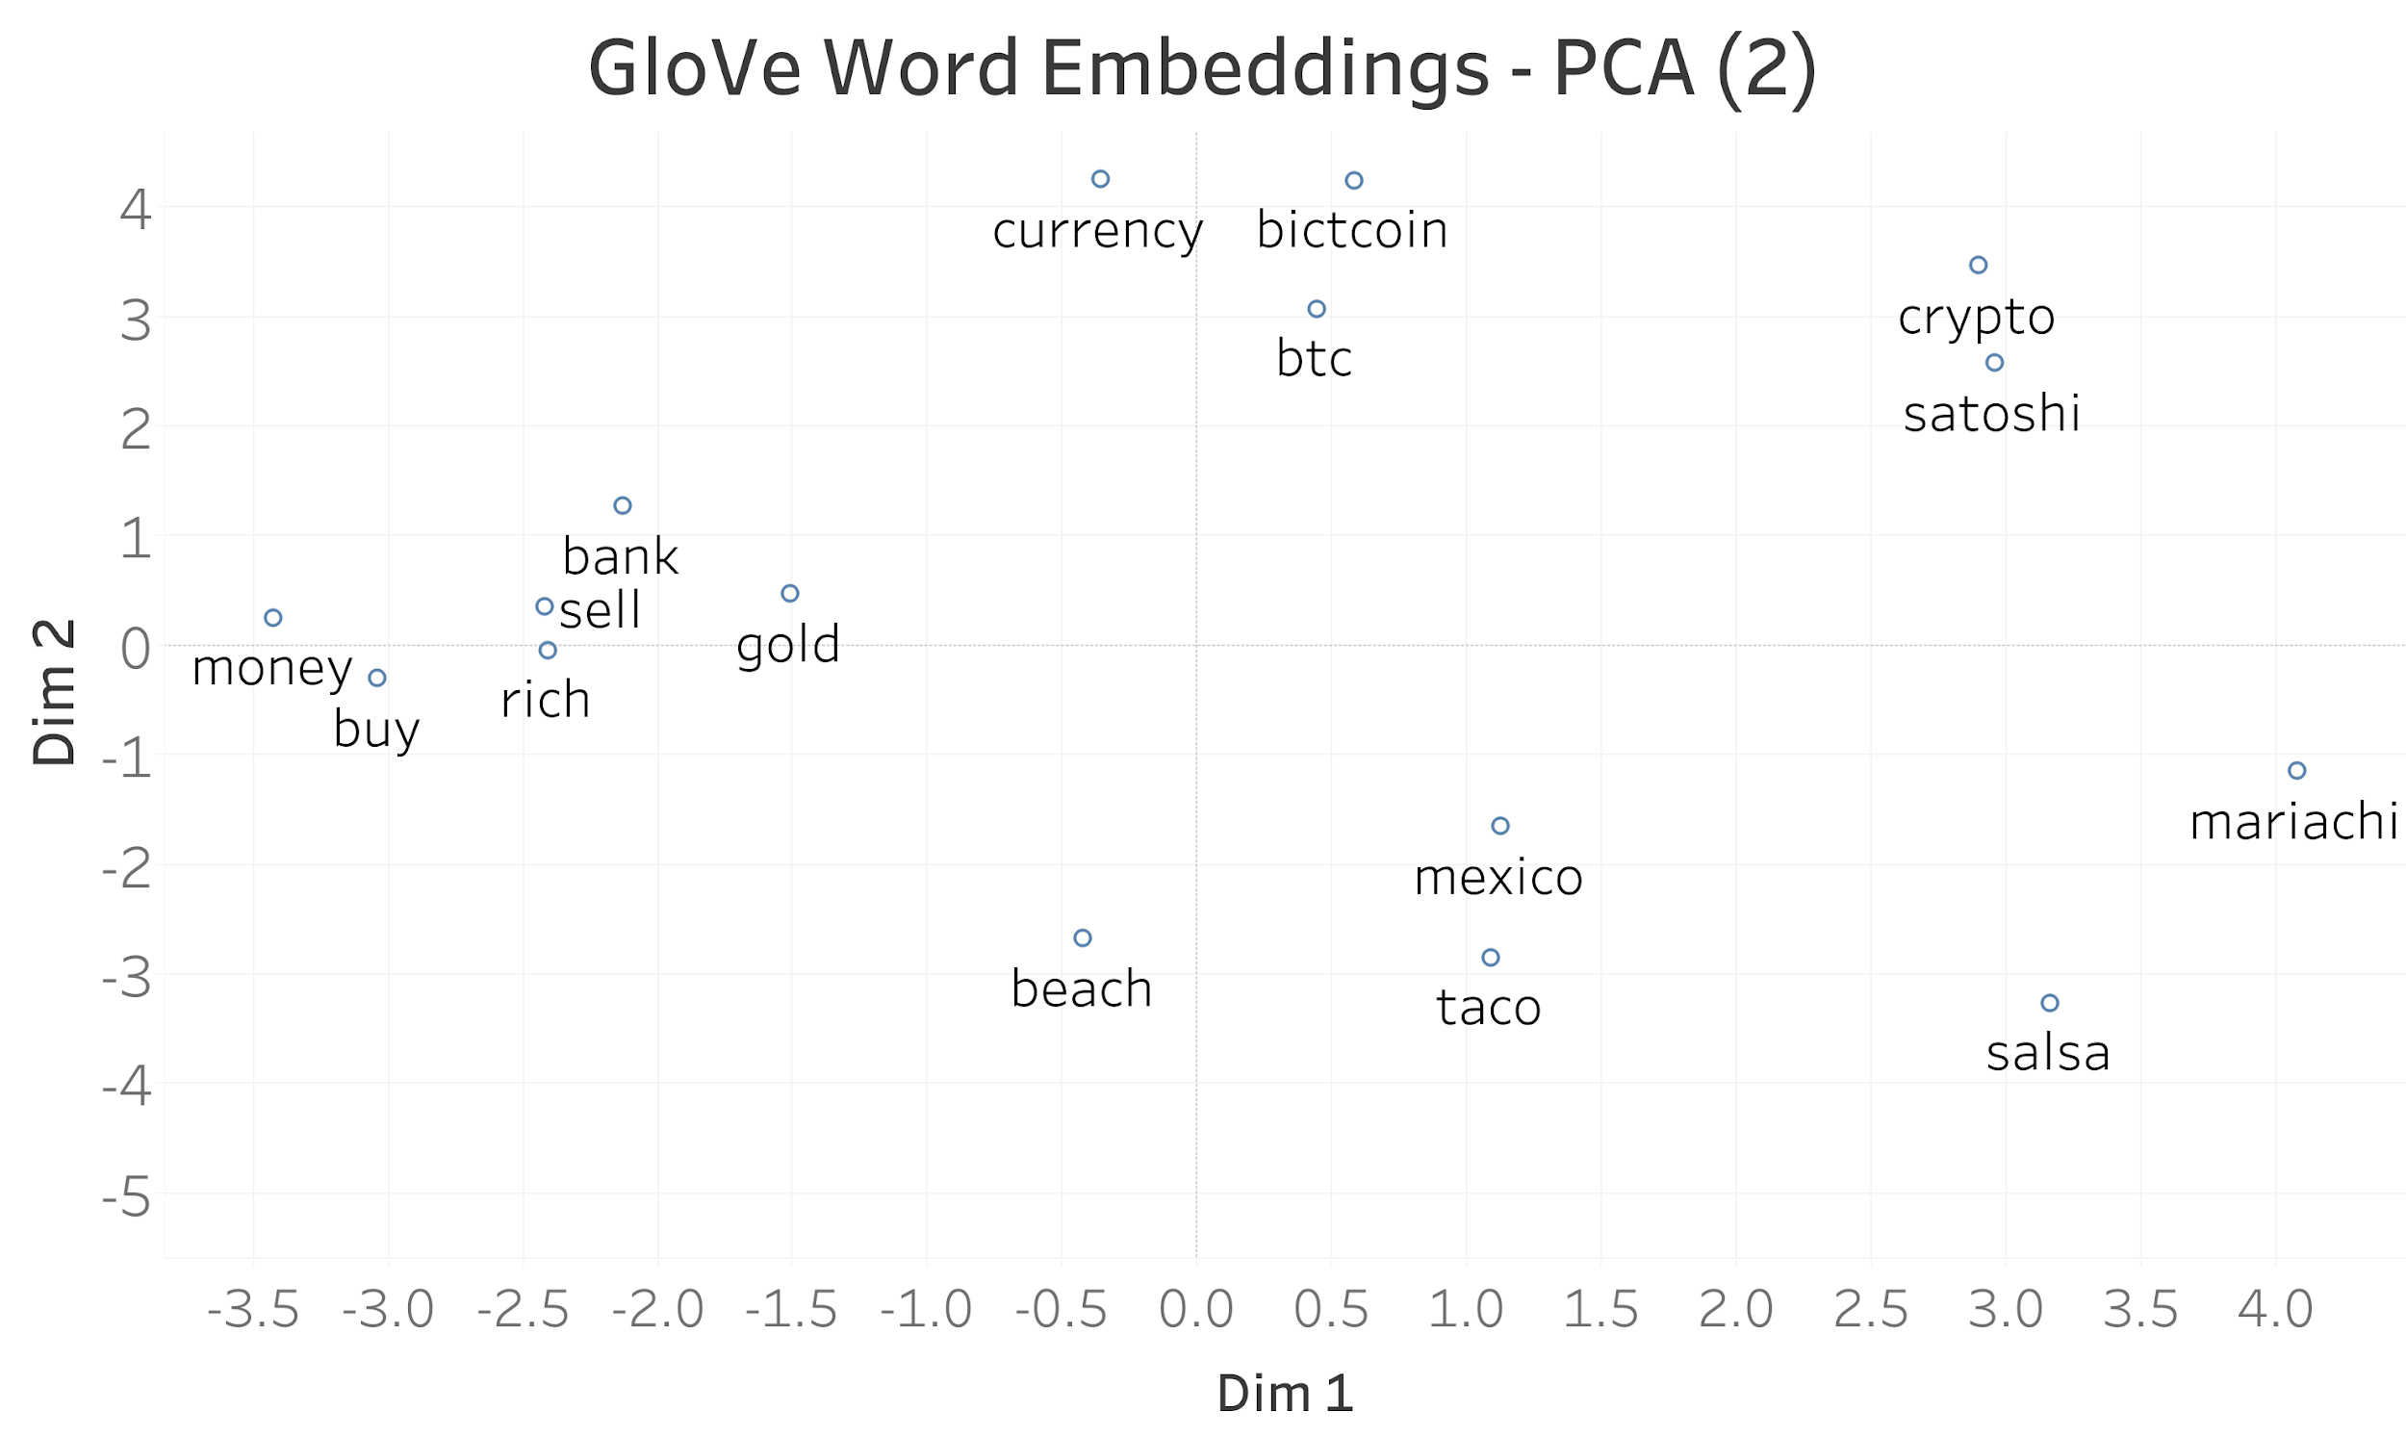
III. Feature Selection
3) Words to Vectors:
Used GloVe^{\1} pre-trained embeddings to get vector representation for each word on each tweet.
The embeddings used are 200 dimensional vectors. Obtained from training on 2 Billion tweets.
1\ GloVe is an unsupervised learning algorithm for obtaining vector representations for words. Training is performed on aggregated global word-word co-occurrence statistics from a corpus, and the resulting representations showcase interesting linear substructures of the word vector space.

Slide 13
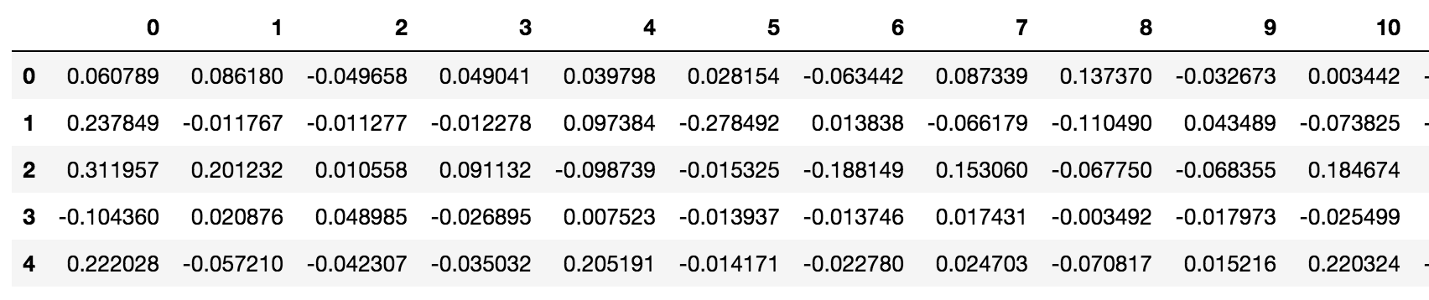
III. Feature Selection
We pick the Word Embeddings because it presented the highest accuracy.
We added 10 lagged movements to capture the “momentum” of the market.
Split into Training Dataset and Testing Dataset (80% - 20%)

Slide 14
IV. Machine Learning Models
Baseline Model
Naive Bayes
Logistic Regression
Decision Tree
Random Forest
Support Vector Machine
Voting Classifier

Slide 15
IV. Machine Learning Models
Baseline Model
First tried to classify with Lexicon list of Positive and Negative Words from previous Sentiment Analysis Models.
Count the occurrences of Positive and Negative Words and classify the tweet accordingly (Net sum positive as +1, otherwise -1)
→ Accuracy: 46.54% < 50% (a random guess)
Probably because the data selection (people related to Bitcoin business)
Random Guess → Accuracy: 50% for balanced dataset

Slide 16
Performance Metrics
Model | Test Accuracy
Naive Bayes | 0.54
Logistic Regression | 0.52
Decision Tree | 0.52
Random Forest | 0.49
SVM | 0.58
KNN | 0.54
Majority Voting | 0.57

Slide 17
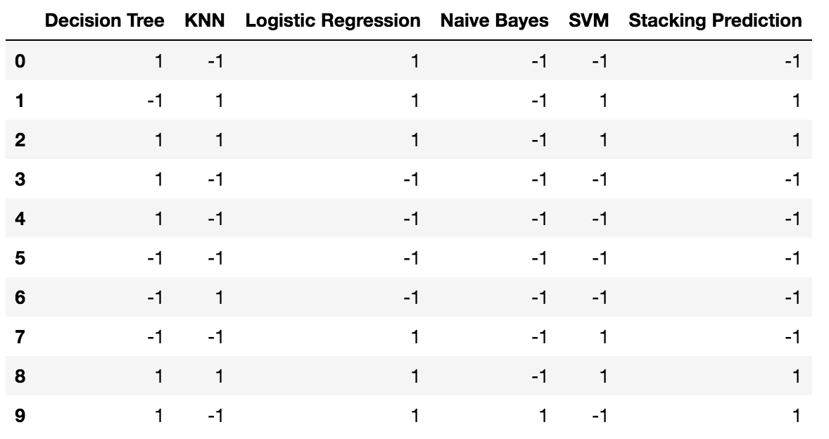
Demonstration of Majority Voting

Slide 18
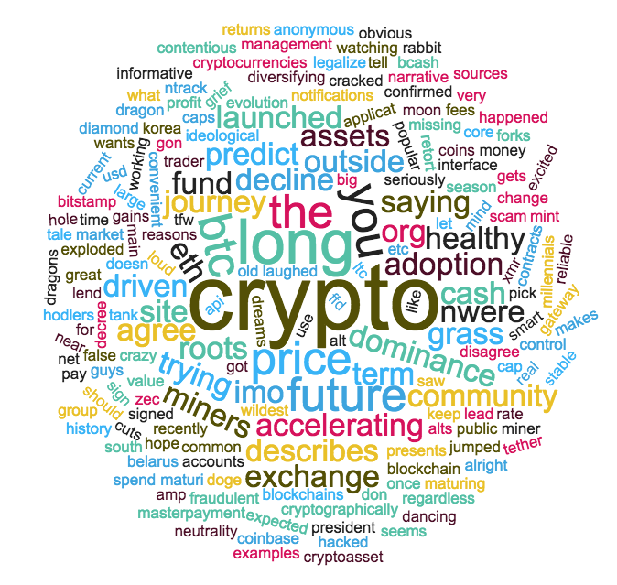
Word Cloud - Most Confident Prediction

Slide 19
VII. Future Work to do
Tweets style not standardized - special characters/abbreviation
No exhaustive filtering method available
Our data has limited and specific type of users (its possible to scrape Twitter regularly to increase variance in users)
Our model does not account for tweet impressions (nor Followers)
Further experiments are needed to disentangle specific causality

Slide 20
THANK YOU!

